Slide 1
How to Make Simple Table Design
Presented By :Er.Sudan prajapati

Slide 2
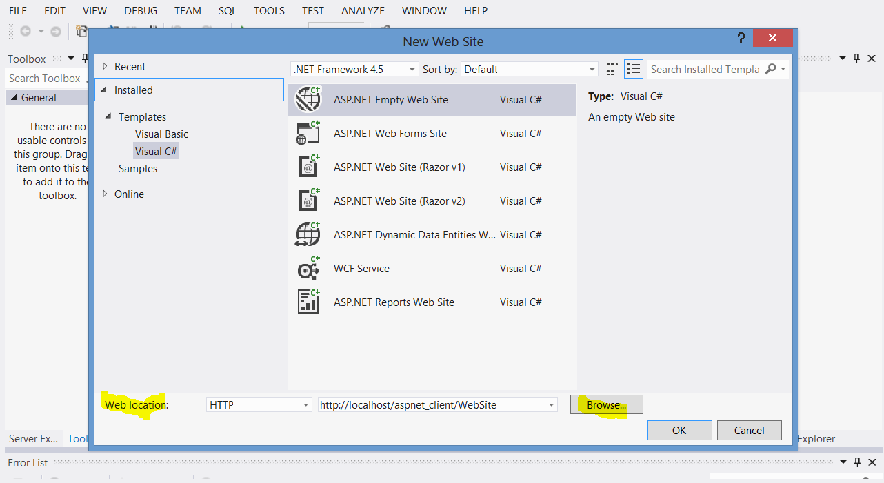
Create a New Web Project
Run Visual studio application as adminsitrator
Select File -> New -> Web Project

Slide 3
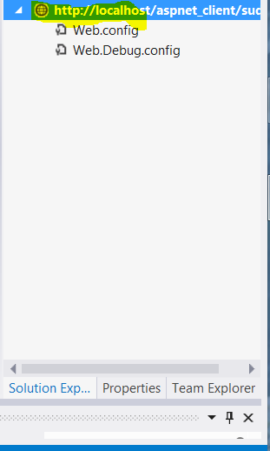
Create the virtual directory and name alias and choose folder as you like
The new empty website will be created.
Add web form by right click in the highlighted item as in figure below and choose new webform:

Slide 4
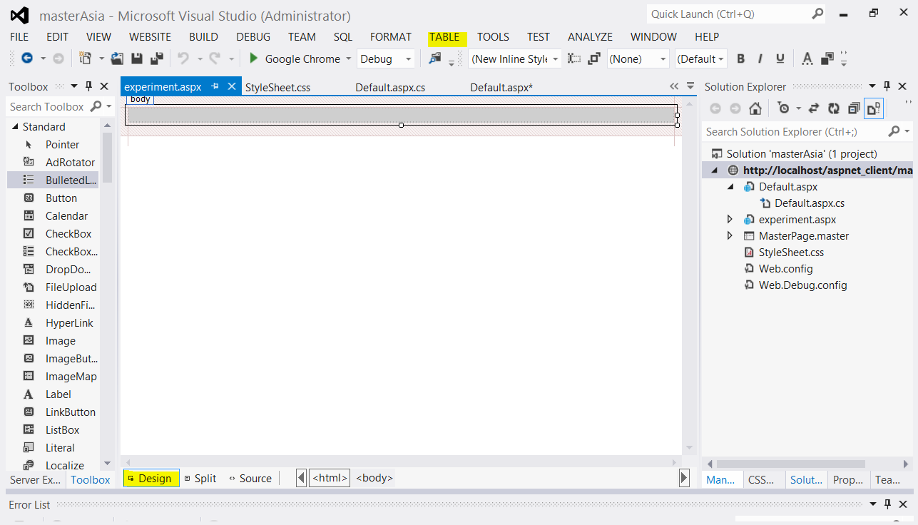
Switch to Design Mode and click Table

Slide 5
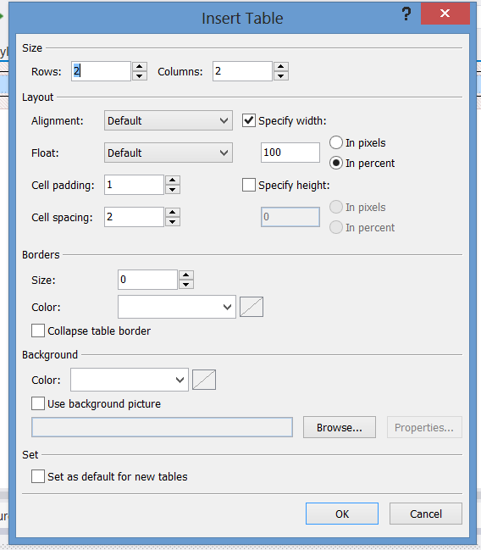
Click add table a Pop Up window will appear

Slide 6
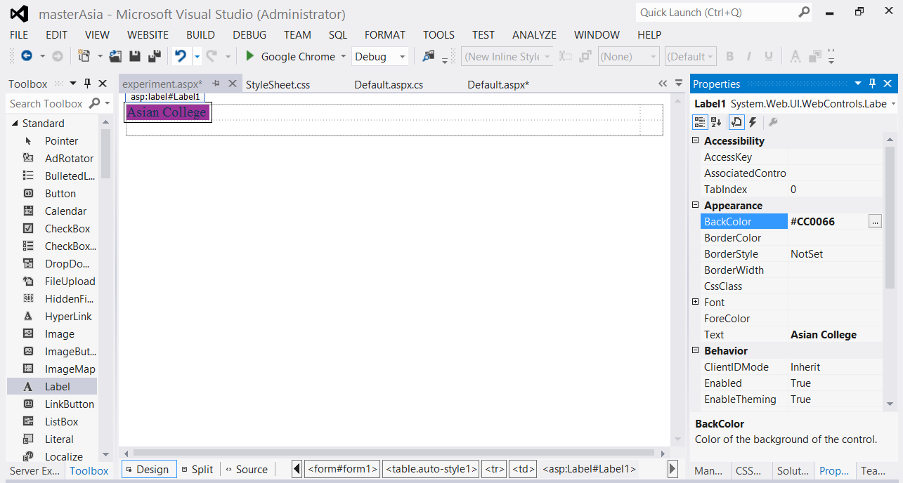
Add Label to first column and name it

Slide 7
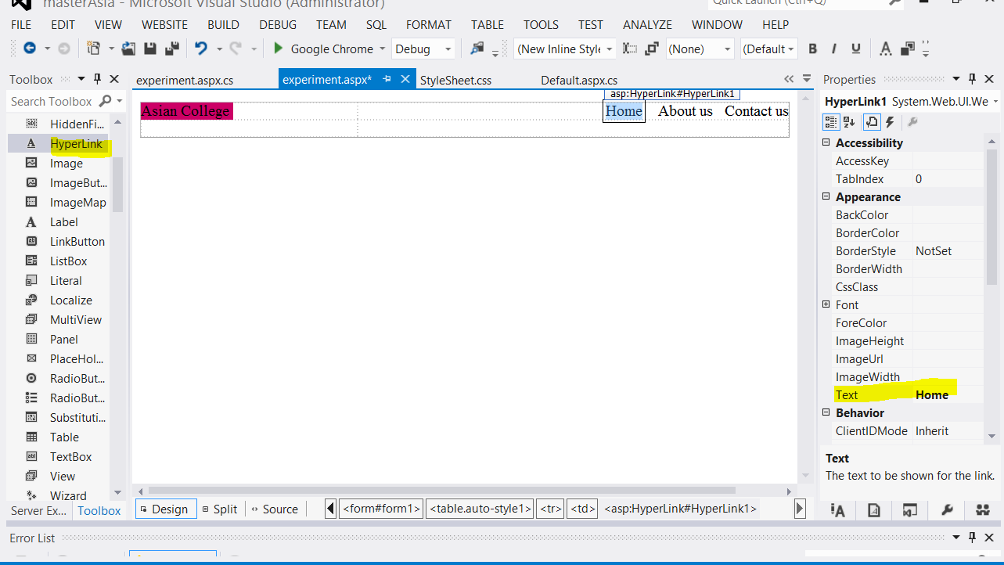
In second column add Hyperlink to second column

Slide 8
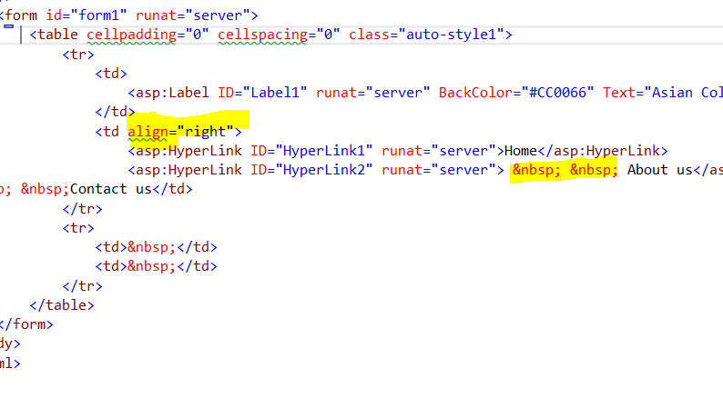
Go to source code add highlighted section

Slide 9
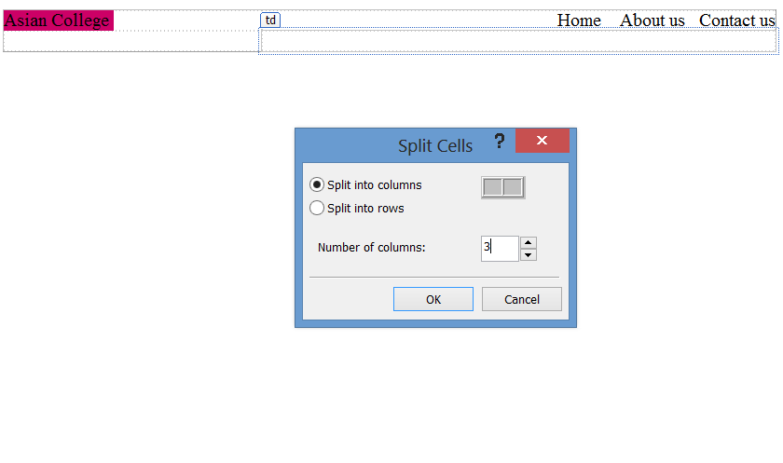
In second row add column

